Slide 1
🐍
Python
Revision Class
1 Variables & Data Types
2 Operators, Input & Output
3 Control Flow - Conditional Logic
4 For Loops
Let's Start! 🚀

Slide 2
01
📦
Variables & Data Types
Labels, memory, objects & type system

Slide 3
1.1 Variables — The Basics
A variable is a label pointing to an object in memory
Created when a value is first assigned (no declaration needed)
Syntax: variable_name = value
Variables can change type after assignment (dynamic typing)
Multiple assignment in one line:
a, b, c = 10, 20, 30
Assign same value to many variables:
x = y = z = 100
Python
# Creating variables
message = "Hello"
print(message) # Hello
num = 100
print(num) # 100
# Type can change
a = "A string"
a = 10 # now int
print(a) # 10
# Multiple assignment
a, b, c = 10, 20, 30
x = y = z = 0

Slide 4
1.2 Variable Naming Rules
✅
Must start with a letter or underscore
var, _var, i, num
❌
Cannot start with a number
1_var → INVALID
❌
Cannot contain spaces
new var → INVALID use new_var
✅
Only letters, digits, underscores
A-Z, a-z, 0-9, _
⚠️
Case-sensitive
number ≠ Number ≠ NUMBER
❌
Cannot be a keyword
if, for, while, break, True…

Slide 5
1.3 Python Data Types
int
float
complex
bool
Whole numbers
Decimal numbers
Real + imaginary
True / False
x = 42
y = 3.14
z = 5+7j
a = True
type() → <class 'int'>
type() → <class 'float'>
type() → <class 'complex'>
type() → <class 'bool'>
str
list
tuple
dict
Text / string
Ordered mutable
Ordered immutable
Key-value pairs
n = "Hi"
lst = [1,2,3]
t = (1,2)
d = {"a":1}
type() → <class 'str'>
type() → <class 'list'>
type() → <class 'tuple'>
type() → <class 'dict'>

Slide 6
1.4 Type Casting (Typecasting)
Converting a value from one type to another
int() — truncates decimals, converts strings
float() — converts to floating-point
str() — converts to string
bool() — 0, empty, None → False
all others → True
⚠️ Always cast input() results before math!
Python
# int()
print(int(10.7)) # 10
print(int("25")) # 25
print(int(True)) # 1
# float()
print(float(10)) # 10.0
print(float("3.14")) # 3.14
# bool()
print(bool(0)) # False
print(bool("")) # False
print(bool([])) # False
print(bool(5)) # True
# str()
age = 25
print("Age: " + str(age))

Slide 7
02
⚙️
Operators, Input & Output
Arithmetic · Assignment · Logical · Relational · print() · input()

Slide 8
2.1 Arithmetic Operators
Operator | Name | Example
+ | Addition | 3 + 2 = 5
- | Subtraction | 5 - 2 = 3
* | Multiplication | 4 * 2 = 8
/ | Division (float) | 7 / 2 = 3.5
// | Floor Division | 7 // 2 = 3
% | Modulus (remainder) | 7 % 2 = 1
** | Exponentiation | 2 ** 3 = 8
a = 10
b = 3
print(a + b) # 13
print(a - b) # 7
print(a * b) # 30
print(a / b) # 3.333...
print(a // b) # 3
print(a % b) # 1
print(a ** b) # 1000

Slide 9
2.2 Assignment & Logical Operators
Assignment Operators
Logical Operators
+=
x += 3 → x = x+3
and
True if BOTH are true
-=
x -= 2
T and T → True
T and F → False
*=
x *= 4
or
True if AT LEAST ONE is true
/=
x /= 2
T or F → True
F or F → False
//=
x //= 2
%=
x %= 3
not
Inverts the boolean value
**=
x **= 2
not True → False
not False → True

Slide 10
2.3 Relational (Comparison) Operators
==
Equal to
5 == 5
True
!=
Not equal to
4 != 3
True
>
Greater than
7 > 2
True
<
Less than
3 < 1
False
>=
Greater than or equal
5 >= 5
True
<=
Less than or equal
6 <= 7
True

Slide 11
2.4 Output — print() & Input — input()
print() displays values to the screen
Multiple values → separate with commas (space in between)
sep= changes separator (default: space)
end= changes line ending (default: \n)
f-strings → f"value is {variable}"
input() always returns a STRING
Cast with int() / float() before doing math
Python
# Basic print
print("Hello", "World") # Hello World
print("A","B","C",sep="-") # A-B-C
print("Line 1", end=" | ")
print("Line 2") # Line 1 | Line 2
# f-strings
name = "Alice"
score = 95
print(f"{name} scored {score}")
# Alice scored 95
# input + casting
age = int(input("Enter age: "))
h = float(input("Height m: "))
print(f"Age in 5 yrs: {age+5}")
print(f"Doubled ht: {h*2}")

Slide 12
03
🔀
Control Flow — Conditional Logic
if · if-else · if-elif-else · nested conditions

Slide 13
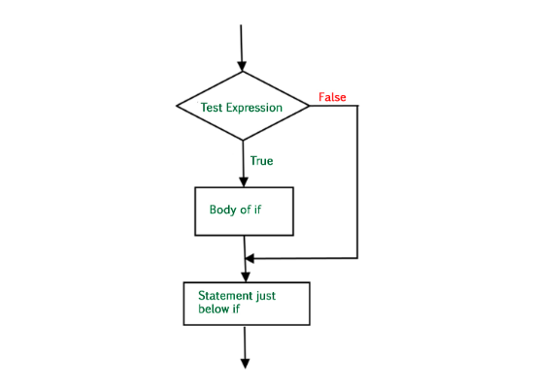
3.1 The if and if-else Statements
if — executes block ONLY when condition is True
else — runs when the if condition is False
Python uses INDENTATION (4 spaces) to define blocks
Colon (:) is required after every if / else / elif
Exactly ONE of the blocks runs — never both
⚠️ IndentationError if you forget to indent!
Python
# if statement
temperature = 30
if temperature > 25:
print("It's warm!") # runs
print("Wear light clothes.")
# if-else statement
age = 16
if age >= 18:
print("Eligible to vote.")
print("Please register!")
else:
print("Not yet eligible.")
print(f"Wait {18-age} more years.")
# Note: exactly one block executes

Slide 14
3.2 The if-elif-else Statement
elif = 'else if' — chains multiple conditions
Python checks conditions TOP to BOTTOM
Stops at the FIRST True condition and skips the rest
else at the end catches anything that didn't match
Use elif when you have MORE than 2 possible cases
Python
temperature = 15
if temperature > 30:
print("Hot outside!")
print("Stay hydrated.")
elif temperature > 20:
print("Warm and pleasant.")
elif temperature > 10:
print("Cool but comfortable.")
print("Light jacket maybe.")
else:
print("Cold outside!")
print("Bundle up!")
# temp=15 matches 3rd condition (15>10)
# → "Cool but comfortable."

Slide 15
3.3 Logical Operators in Conditions
and → BOTH conditions must be True
or → AT LEAST ONE must be True
not → REVERSES the Boolean value
Use parentheses for complex expressions
Combine and, or, not for powerful checks
# and operator
age = 25; has_license = True
if age >= 18 and has_license:
print("Can drive legally!")
else:
print("Cannot drive.")
# or operator
day = "Saturday"
if day == "Saturday" or day == "Sunday":
print("Weekend! No work.")
# not operator
is_raining = False
if not is_raining:
print("Great day for a walk!")
# Combined
gpa = 3.7; status = "undergraduate"
if (18 <= age <= 25) and (status=="undergraduate" or
status=="graduate") and gpa>=3.5:
print("Scholarship eligible!")

Slide 16
3.4 Nested Conditional Statements
Place if statements INSIDE other if blocks
Each nested level adds 4 more spaces of indentation
Creates tree-like decision structures
Inner checks run ONLY if outer condition is True
Useful for hierarchical or sequential decisions
weather = "sunny"
temperature = 28
has_sunscreen = True
if weather == "sunny":
print("It's a sunny day!")
if temperature > 25:
print("Also quite warm.")
if has_sunscreen:
print("Enjoy the beach!")
else:
print("Apply sunscreen first.")
else:
print("Sunny but cool. Walk!")
else:
print("Not sunny today.")
if weather == "rainy":
print("Don't forget umbrella!")
elif weather == "cloudy":
print("Good for indoor activities.")

Slide 17
04
🔁
For Loop
range() · loop body · break · continue · nested loops

Slide 18
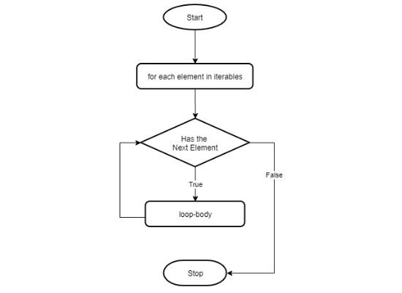
4.1 For Loop & range() Function
for loop — repeats code for each item in a sequence
range(stop) → 0, 1, …, stop-1
range(start, stop) → start, …, stop-1
range(start, stop, step) → custom increments
Negative step → countdown
Loop variable (i) holds current value each iteration
Loop body must be INDENTED
# Basic counting
for i in range(5): # 0,1,2,3,4
print(f"Number: {i}")
# From 1 to 5
for n in range(1, 6): # 1,2,3,4,5
print(f"Number: {n}")
# Even numbers 2-10 (step 2)
for even in range(2, 11, 2):
print(f"Even: {even}")
# Countdown from 5 to 1
for x in range(5, 0, -1):
print(x)
# Sum 1 to 10
total = 0
for num in range(1, 11):
total += num
print(f"Sum = {total}") # 55

Slide 19
4.2 Loop Control — break & continue
break → EXIT the loop immediately
continue → SKIP current iteration, go to next
break is useful when you've found what you need
continue is useful to skip unwanted values
Both work inside for and while loops
# break — exit when found
for num in range(1, 50):
if num % 7 == 0:
print(f"First div by 7: {num}")
break # found! stop loop
print(f"{num} not divisible")
# → First div by 7: 7
# continue — skip even numbers
for num in range(1, 11):
if num % 2 == 0:
continue # skip evens
print(f"Odd: {num}")
# → Odd: 1, 3, 5, 7, 9
# Loop with accumulator
total = 0
for i in range(1, 6):
total += i
print(f"Sum 1-5 = {total}") # 15

Slide 20
4.3 Nested Loops
A loop inside another loop
Outer loop = rows, Inner loop = columns
Inner loop runs COMPLETELY for each outer iteration
Total iterations = outer × inner
Use end="" to print on the same line
print() with no args moves to next line
Great for: patterns, multiplication tables, 2D data
# Star triangle pattern
rows = 5
for row in range(1, rows+1):
for item in range(row):
print("*", end="")
print() # move to next line
# *
# **
# ***
# ****
# *****
# Multiplication table
n = int(input("Enter number: "))
for i in range(1, 11):
print(f"{n} x {i} = {n*i}")
# Number staircase
for r in range(1, 6):
for c in range(1, r+1):
print(c, end="")
print()
# 1 12 123 1234 12345

Slide 21
Practice Problems at a Glance 📝
Variables
Operators
Assign 'Python' to language and 2025 to year. Print both with type().
Take two numbers from user. Print sum, difference, product, quotient.
Boolean
if-elif-else
Assign True to x, False to y. Print: x and y, x or y, not x.
Input exam mark (0-100). Print Pass (≥40), Fail (<40), or Invalid.
Nested if
For loop
Leap year checker: divisible by 4, but not 100 unless also by 400.
Print all even numbers from 1-100. Find their sum.
Nested loops
Bill Generator
Print a 5-row number triangle: 1 / 12 / 123 / 1234 / 12345.
Input item name, quantity (int), price (float). Print total with f-strings.

Slide 22
🎯
You've Got This!
Review the slides · Practice the exercises · Ask questions!
Variables 📦
Data Types 🔢
Operators ⚙️
print() 🖨️
input() ⌨️
if-elif-else 🔀
Loops 🔁
break/continue ⛔

